Slide 1
PRESENTATION ON MINI PROJECT

Slide 2
PROJECT ON
LINGUISTIC SIGN TRANSLATOR

Slide 3
GROUP MEMBERS : SHREYASKAR JAISWAL(LEADER) AINDREE ANIL AMAN SINGH RITU PARNA BANERJEE

Slide 4
INTRODUCTION :
The world is hardly live without communication , no matter whether it is in the form of visual , or voice or gestures.
Our project constructed the model to understand the sign language from the user (can be mute or normal) and translated it into the understandable text.

Slide 5
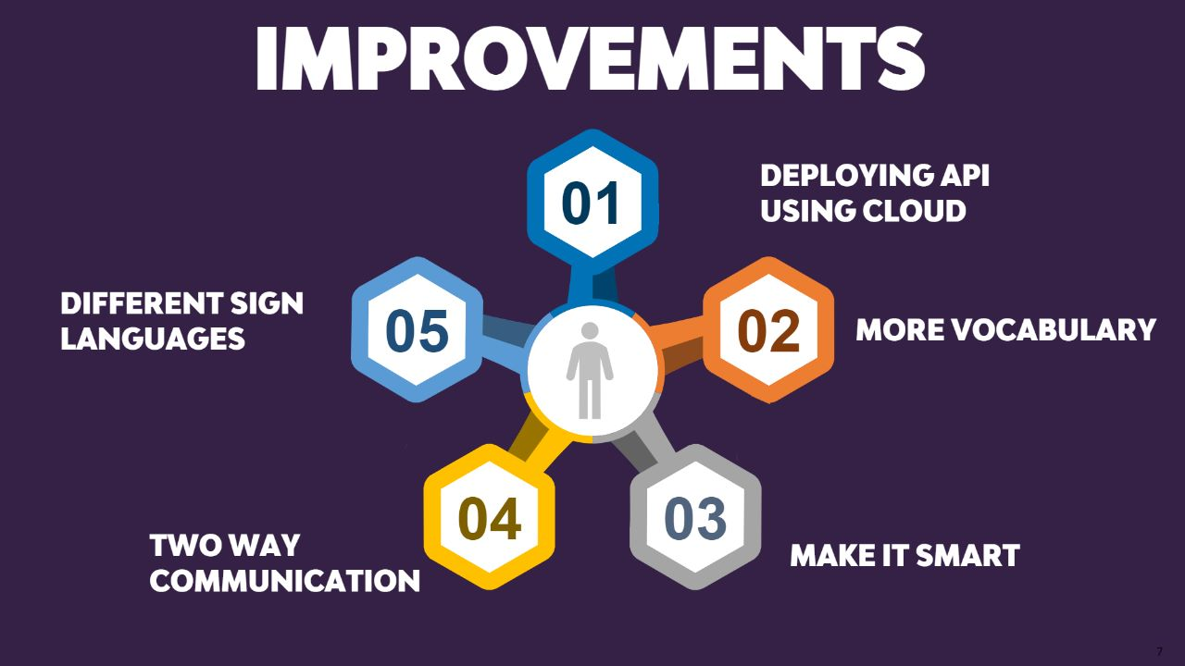
OBJECTIVE :

Slide 6
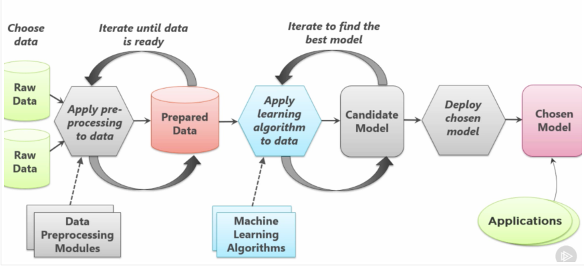
We have selected the sign language dataset and from that dataset we have fetched the images. Using image processing we have converted those images into pixels by CNN.
METHODOLOGY:

Slide 7
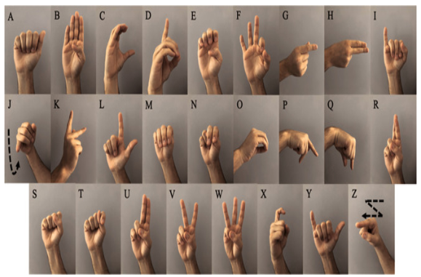
SIGN LANGUAGES

Slide 8
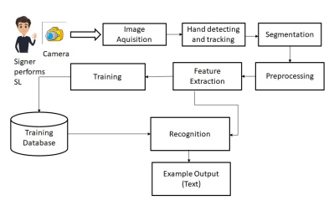
BLOCK DIAGRAM :

Slide 9
• Visual Studio Code • Scikit-Learn • Open CV • Datasets • Internet Connection
SOFTWARE REQUIREDS: HARDWARE REQUIREDS
• Web Camera
• Processor: Up to 3Gb RAM
Graphics Card (optional)

Slide 10
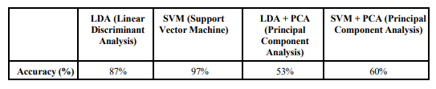
TECHNIQUES USED:
Machine Learning:
LDA (Linear Discriminant Analysis), PCA (Principal Component Analysis) and SVM (Support Vector Machine). We used PCA to reduce features, then we used these features in LDA and SVM algorithms. We used scikit-learn library to implement these algorithms.

Slide 11
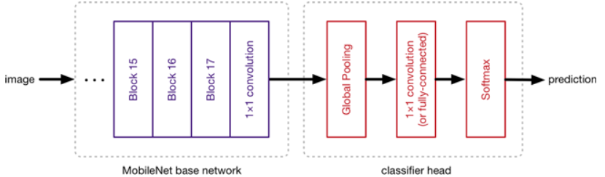
TECHNIQUES USED:
SSD Mobile net V2:
The Mobile Net SSD model is a single-shot multi box detection (SSD) network that scans the pixels of an image that are inside the bounding box coordinates and class probabilities to conduct object detection.

Slide 12
NEED FOR THIS PROJECT :
• 1 Million Deaf people who use American Sign Language as
their primary language.
• 30 Million Americans hear at 40 decibels (dB) or higher.
"Normal" hearing ranges from 0 to 20 dB.
• 70 Million Deaf people around the world use sign language
• 98% of Deaf people this world do not receive education in sign
language.
• 72% of families do not sign with their Deaf children.
• 70% of Deaf people don't work or are underemployed.
1 in 4 Deaf people have quit a job due to discrimination.

Slide 13
FUTURE SCOPE:
The implementation of our model for other sign languages such as Indian sign language or American sign language.
Further training the neural network to efficiently recognize symbols.
Enhancement of model to recognize expressions.

Slide 14
THANK YOU

